Slide 1


Here's your outline to get started
Key facts about your topic
Market research is an organized effort to gather information about target markets or customers. It is a very important component of business strategy. The term is commonly interchanged with marketing research; however, expert practitioners may wish to draw a distinction, in that marketing research is concerned specifically about marketing processes, while market research is concerned specifically with markets.
See more: Open the Notes below for more information.
Notes:
QuickStarter has created an outline to help you get started on your presentation. Some slides include information here in the notes to provide additional topics for you to research.

Slide 2

Related topics to research
Marketing
Test market
Ipsos
Mintel
International Data Corporation
Kantar Group
IRI
Frost & Sullivan
Coolhunting
Mystery shopping
Use Smart Lookup to learn more
1
Highlight one of the related topics
Right-click on the topic
Choose "Smart Lookup"
2
3

Slide 3

How will Disney compete with Netflix?
A comparative study

Slide 4
Contents
Research Question
Comparison of the contents
Disney’s Growth strategy based on it’s competitive edge
Further discussions

Slide 5
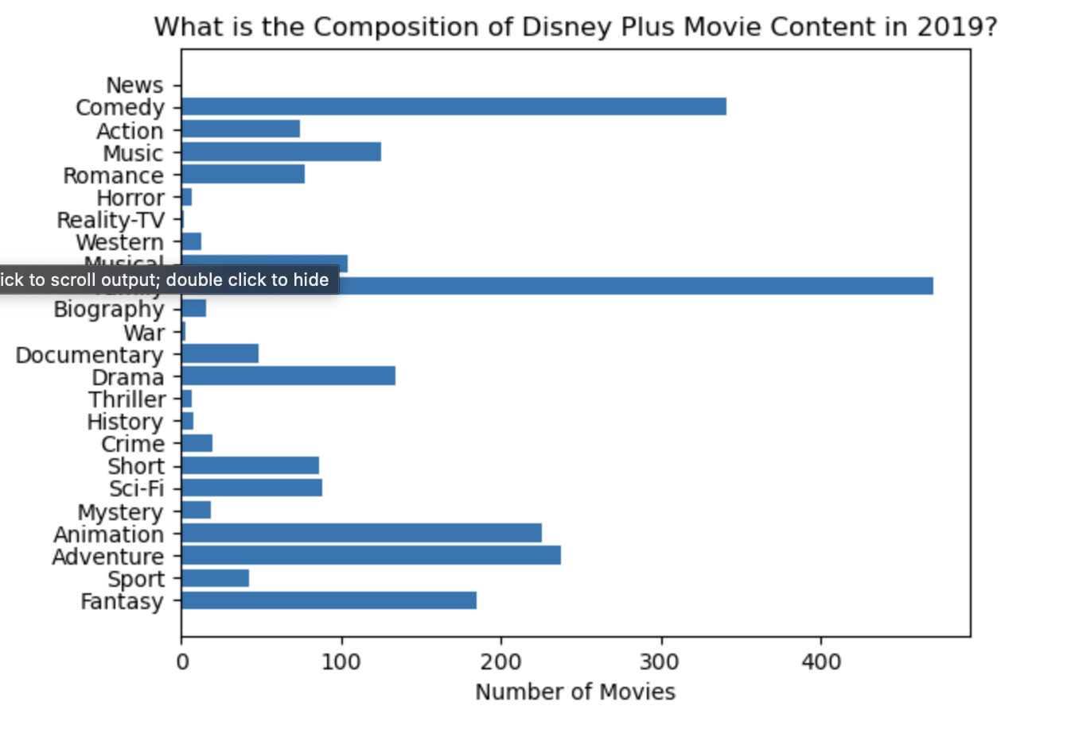
Research Question
How do the movies in Disney’s top most produced genres perform in terms of ratings as compared with Netflix’ movies of the same genres?
How should Disney Plus’ form its strategy going forward to maintain it’s competitive edge?

Slide 6
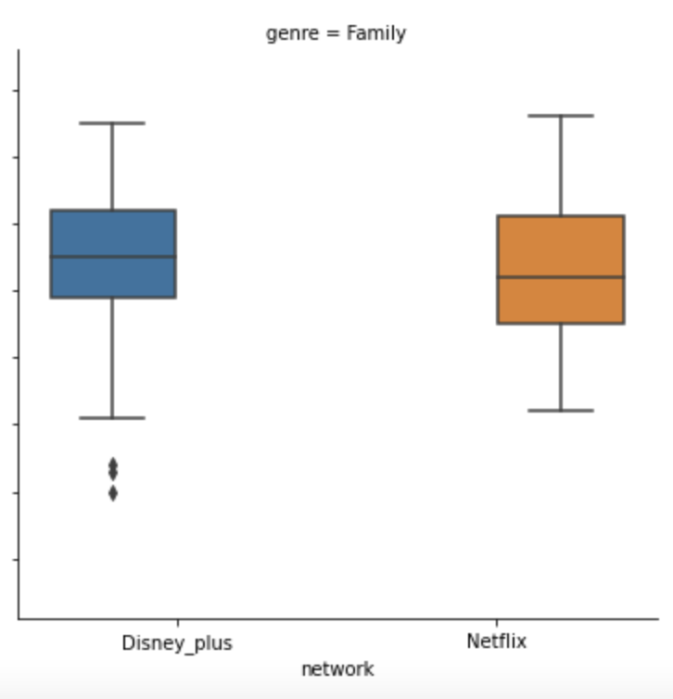
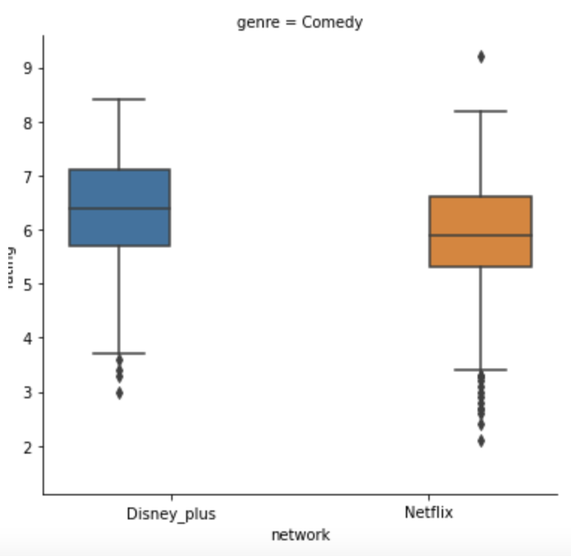
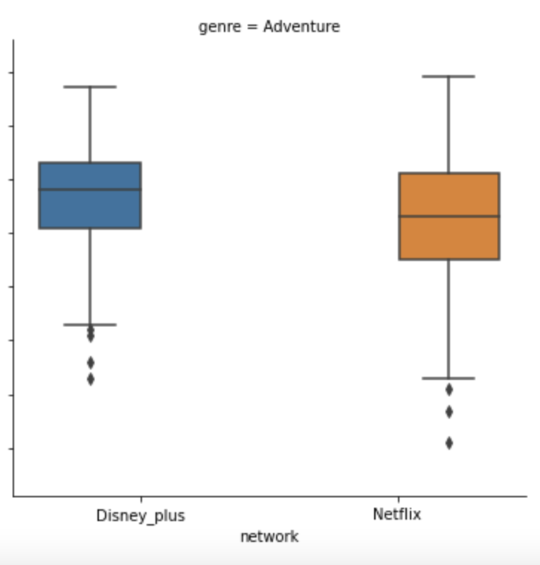
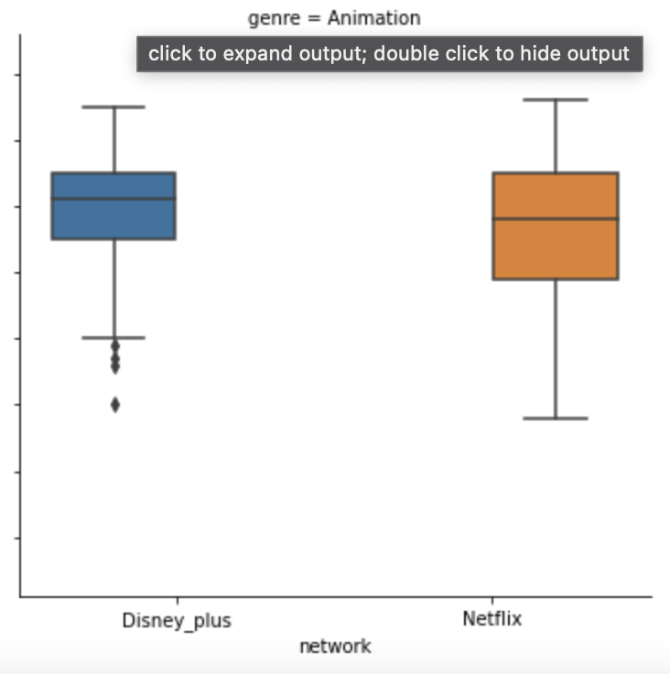
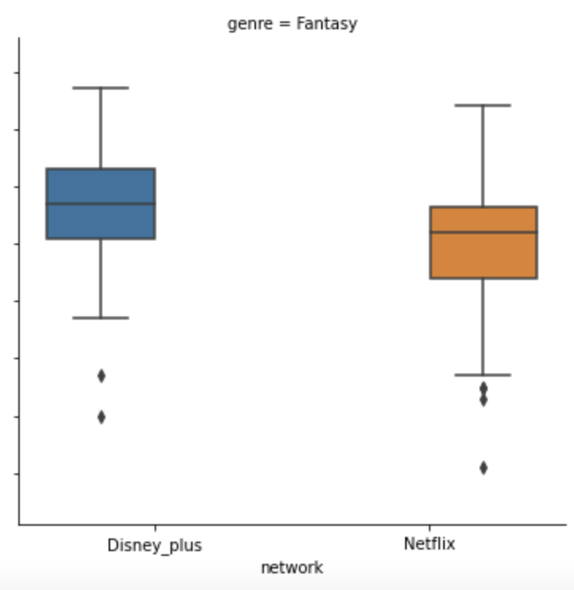
Families, Comedies, Adventures, Animations and Fantasies

Slide 7
Other genres?

Slide 8
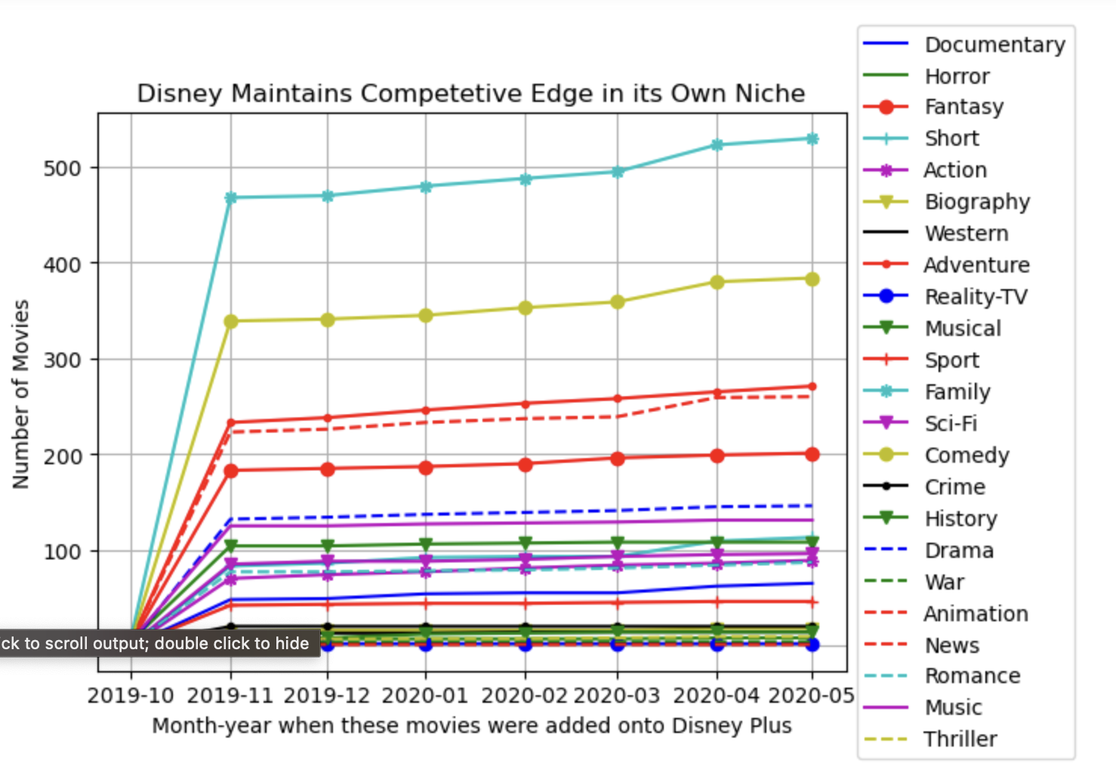
How did Disney Plus grow its movie contents since its launch?

Slide 9
Research and market sectors

Slide 10
Works cited

